Slide 1


TP 2 Enterprise Service Bus
Universidad: Cuenca Del Plata
Facultad: Ingenieria en sistemas de la informacion
Profesor: Jose Fernandez
Alumno: Schleicher Leonel
Año: 2019

Slide 2
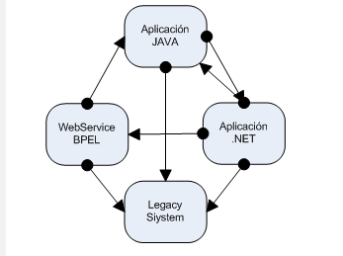
greater complexity
Rigid design, not very flexible to changes and difficult to maintain
high coupling
Secutiry of the information. Disparity between app (comunication and vulnerability problems)

Slide 3
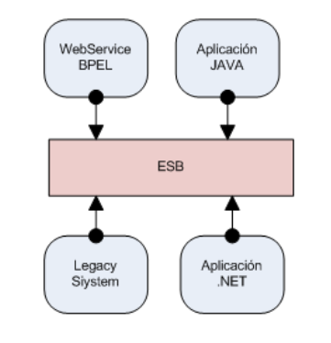

Slide 4
Features/Advantages
*Gateway to the world
*Transport protocol conversion
*Transform message format (XML to JSON)
*Protect services from unauthorized access
*Monitoring (responses times, number of executions)

Slide 5
Disadvantages
Single point of failure
Decrease in communication performance
Cost of license
Vendor locking
Find qualified staff

Slide 6
Providers
OpenESB implementación en Java. Oracle ESB Oracle Service Bus (BEA AquaLogic Service Bus) Microsoft BizTalk Server Windows Azure Service Bus IBM WebSphere ESB
WSO2

Slide 7
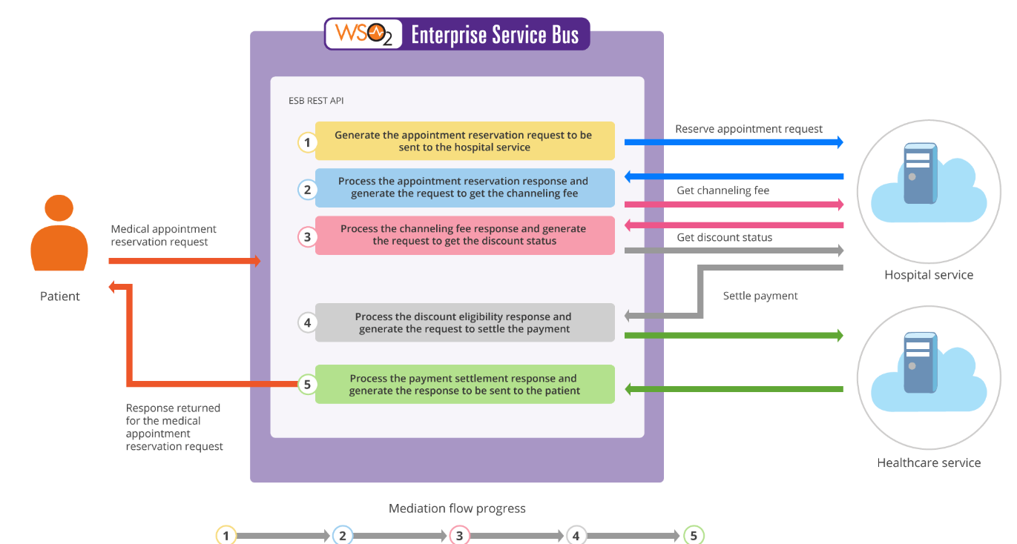
Example

